Slide 1
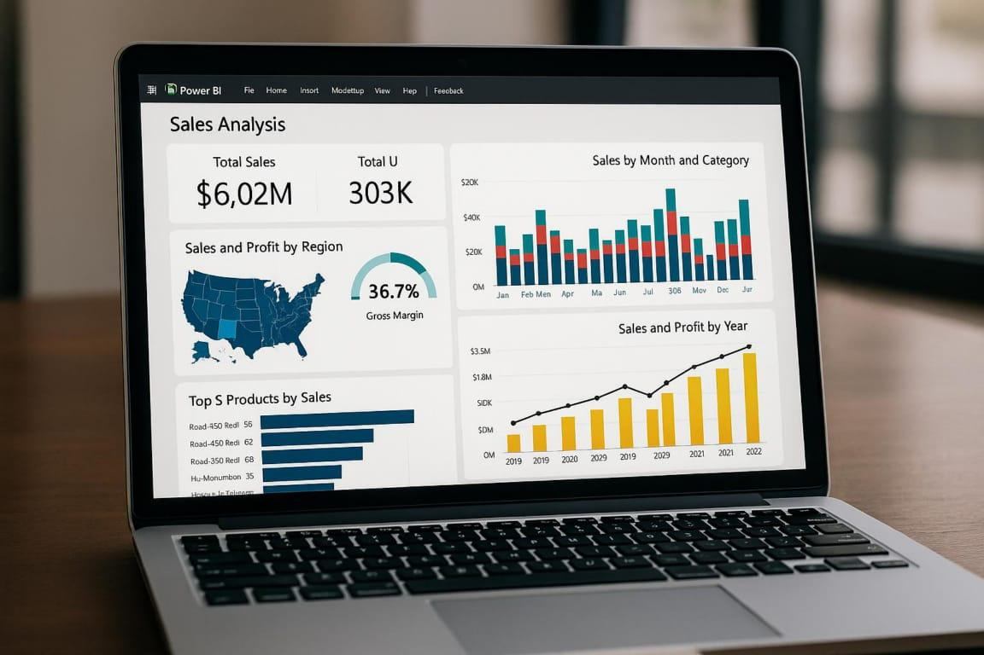
Maureen Ndungu
Data analyst
YOUR PARTNER IN TURNING DATA INTO DECISIONS.

Slide 2


Introduction
About me
Hello, I'm Maureen, a curious and impact-driven data analyst passionate about turning raw data into strategic insight. With hands-on experience from leading organizations like Mpshah Hospital, Jubilee Insurance, Tuffsteel, and Simba Corporation, I specialize in data cleaning, ETL, visualization, and business process optimization using tools like Power BI, SQL, and Excel.
What sets me apart is my ability to merge technical skill with real-world impact—from streamlining fleet systems to influencing marketing campaigns and supporting environmental CSR projects. I have recently advanced my skills through the ALX Data Science program; I’m eager to bring analytical clarity and storytelling power to teams tackling meaningful challenges.
Whether it’s enhancing decision-making or contributing to sustainable development, I’m driven by purpose and powered by data.

Slide 3

Education
ALX Kenya
October 2025 - February 2026
Data Science
ALX Kenya
August 2025 - October 2025
Python Programming
ALX Kenya
April 2025 - Aug 2025
Data Analytics
ALX Kenya
Jan 2025 - April 2025
Professional Foundations
Mount Kenya University
Sep 2020 - Dec 2023
Bachelor of Science in Statistics

Slide 4
Work Experience
ICT Intern - MP Shah Hospital Nairobi
September 2025 - March 2026
Systems & ICT Support:
First-line user support (internal and external users)
ICT troubleshooting, system configuration & documentation
Incident tracking, preventive maintenance & service reporting
Data Analytics & Reporting:
Data extraction, cleaning, validation, and reconciliation
SQL, Excel (advanced), Power BI dashboards & reports
Data quality checks and timeliness monitoring
Analytical reporting and management briefs
Data Analytics and Operations
Developed analytical reports and presentations for management to drive service optimization and decision-making.
Led data validation and training efforts for institutional projects to maintain high standards of data accuracy.

Slide 5
Work Experience
Business Analyst and Marketing Intern- Jubilee Insurance, Nairobi
June 2024 - December 2024
Data Management and Reporting:
Merged insurance data using SOV-ATL to support Power BI dashboard development.
Generated a digital footprint report analyzing the company’s online presence.
Distributed daily industry reports to company-wide departments for insight alignment.
Marketing Campaign support and Strategy:
Supported the Maisha Fiti App Activation campaign, increasing downloads significantly.
Contributed to the Live Free Race and Thematic Campaign through digital content insights.
Participated in strategy meetings, offering performance analysis and reporting.
CSR and Community Engagement:
Conducted interviews at Jaipur Foot Centre, documenting challenges of amputee children.
Played a key role in organizing ESG initiatives, including planting 500+ trees in schools.
Created content and summaries for the company’s CSR reports.

Slide 6
Work Experience
Data Analyst intern - Tuffsteel Limited, Nairobi
September 2023 - February 2024
Data integrity and Auditing:
Conducted thorough data integrity checks across fleet systems.
Verified compliance with industry standards through internal audits.
Compiled actionable audit reports for process improvement.
System evaluation and Gap analysis:
Evaluated performance of fleet management software for inefficiencies.
Conducted gap analysis to recommend system enhancements.
Identified optimization opportunities to boost operational efficiency.
Documentation and Training:
Created detailed training materials for new system procedures.
Ensured smooth employee transition to updated workflows.
Standardized reporting procedures to improve internal communication.

Slide 7
Work Experience
Business Analyst intern - Simba Corporation Limited, Nairobi
May 2023 - August 2023
Data cleaning and Preparation:
Cleaned and preprocessed raw data from various departments using Dynamics 365.
Ensured accuracy and uniformity of datasets before analysis.
Consolidated fragmented data into centralized dashboards.
Data Visualization and Insights:
Designed interactive Power BI dashboards for real-time reporting.
Presented insights to stakeholders for strategic decision-making.
Tailored visuals for marketing, operations, and management teams.
Market and Trend analysis:
Analyzed share of voice and product consumption across key markets.
Identified shifts in consumer behavior and purchasing trends.
Delivered actionable insights for product and marketing strategy.

Slide 8
Area of Expertise
Data Analysis and Visualization
Data cleaning and Preparation
Business and Market analysis
Build interactive dashboards using Power BI.
Perform data exploration using Excel and Python.
Translate complex data into actionable insights.
Present findings in reports and presentations.
Track KPIs and support data-driven decisions.
Identify and handle missing or duplicate data.
Standardize and structure raw datasets.
Merge datasets from multiple sources.
Apply formulas and transformations in Excel & SQL.
Prepare data for visualization and modeling.
Analyze market trends and product performance.
Study customer behavior and share of voice.
Support campaign performance measurement.
Perform gap analysis in business processes.
Recommend data-driven strategic improvements.

Slide 9
Area of Expertise
Technical Tools & Skills
Project & Client Support
Community & Impact-Driven Data Projects
Use Power BI and Excel for dashboards and reporting.
Leverage Excel for calculations, cleaning, and charts.
Write SQL queries for data extraction and analysis.
Performing preventive maintenance on computers.
Virtualization and Cloud Computing
Collaborate with teams to deliver data insights.
Prepare reports and presentations for stakeholders.
Manage community-based data collection projects.
Track progress and impact of ESG/CSR initiatives.
Deliver timely freelance reports and analytics.
Lead data collection in grassroots development projects.
Analyze population data to inform fair resource distribution.
Support sustainability efforts with evidence-based reporting.
Engage communities in data-backed planning discussions.
Create summaries and reports to drive social impact.

Slide 10

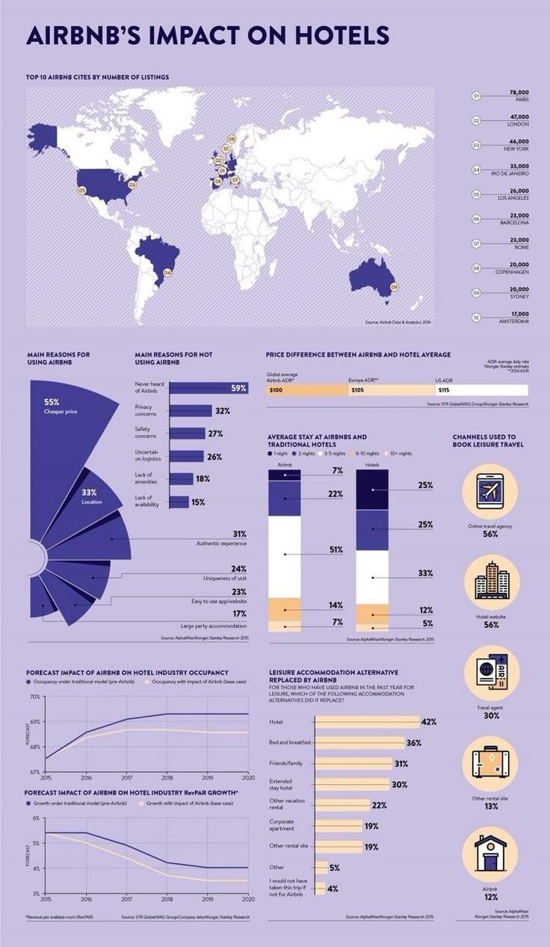
Why Choose me
Insight-Driven Approach: I don’t just analyze numbers — I uncover the stories behind them to help teams make smarter, faster decisions.
Proven Real-World Impact: From corporate analytics to community data projects, I’ve helped improve reporting, resource allocation, and digital campaign performance.
Strong Technical Foundation: With hands-on experience in Power BI, SQL, Python, and Excel, I bring both the tools and the thinking to solve problems efficiently.
Purpose-Led Mindset: I care about using data for good, supporting business growth, social impact, and community development with every project I take on.

Slide 11

Personal Skills
Technical Skills
Power Bi
Excel
Canva
Virtual Box
PowerPoint
Outlook
ChatGPT
90 %
95%
90 %
Time Management
Tech
Organization
Savvy
Ubuntu Operating System
Google Sheets
Teams
MySQL
90%
85 %
85%
Emotional Intelligence
Adaptability
Communication

Slide 12

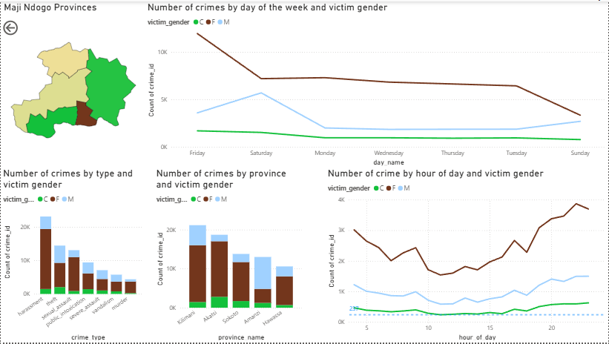
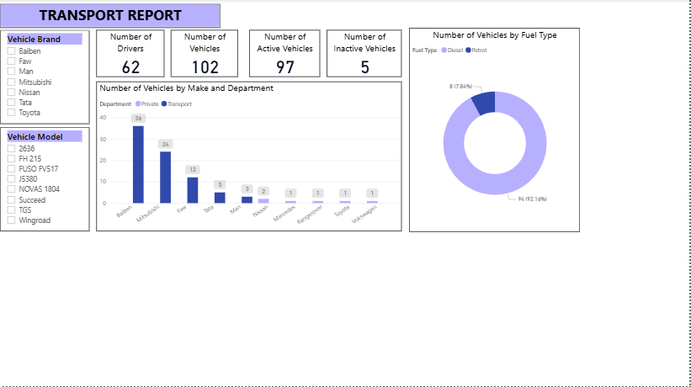
Projects
Maji Ndogo Crime by gender Report
Transport Report

Slide 13
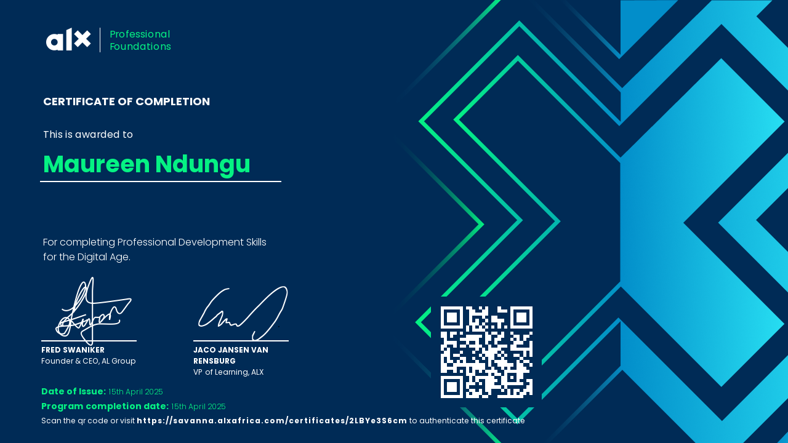
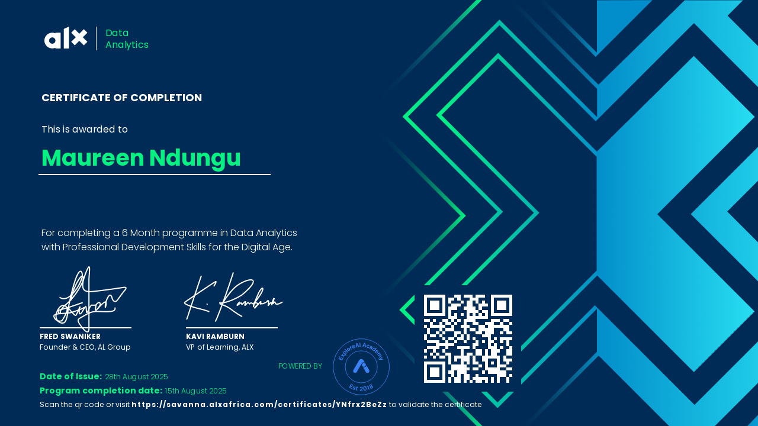
CERTIFICATES
PROFESSIONAL FOUNDATIONS
DATA ANALYTICS

Slide 14
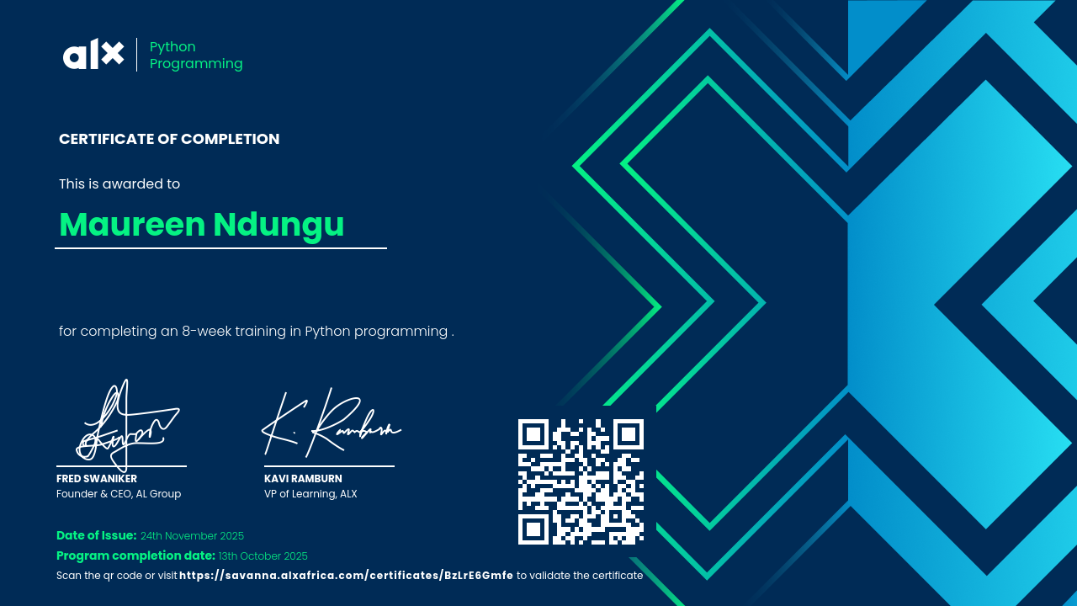
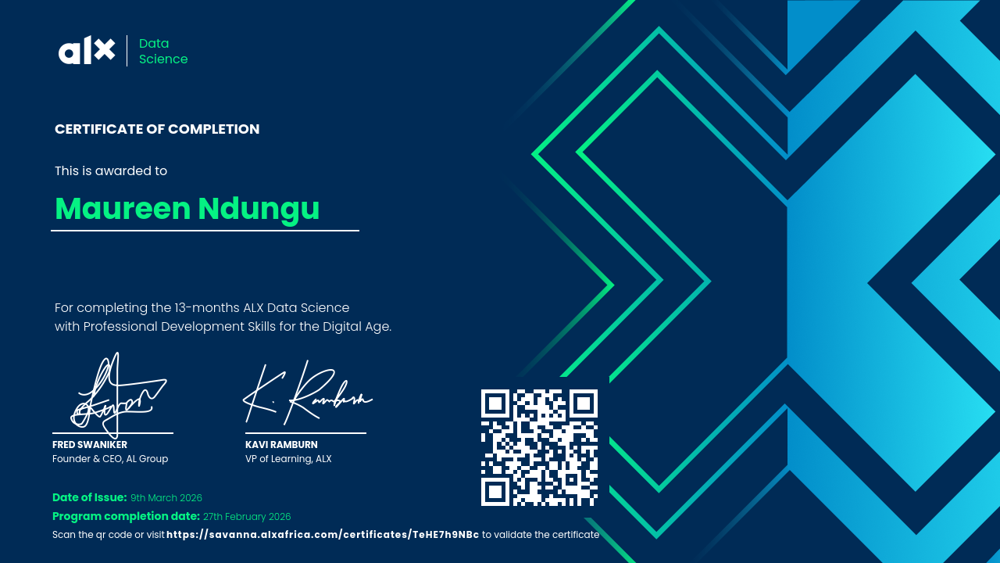
CERTIFICATES
PYTHON PROGRAMMING
DATA SCIENCE

Slide 15
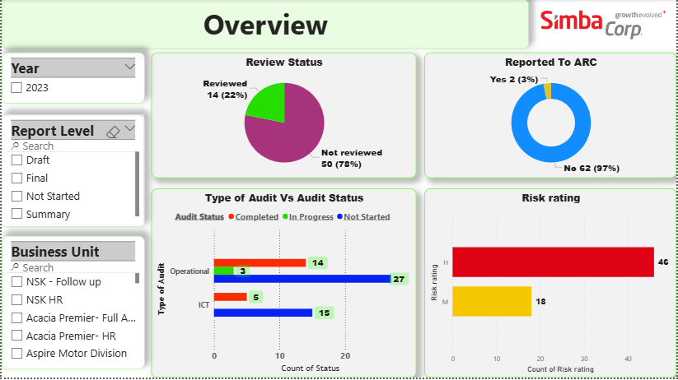
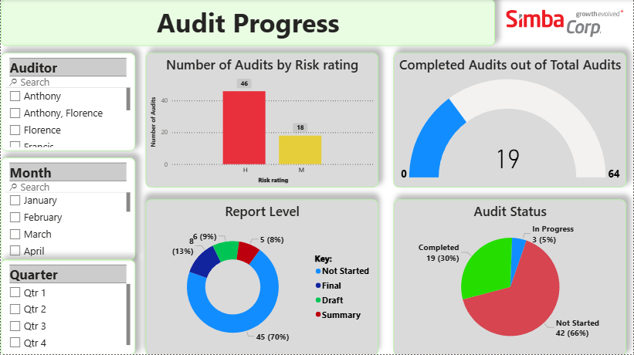
Projects
Audit Report for companies under Simba Corporation

Slide 16



Referees
Dr Amadeo Gikunda
Daniel Mwendwa
Mbarak Ahmed
Coordinator Natural Sciences, Mount Kenya University
Data Analyst, Simba Corporation
ICT Support Manager,
MP Shah Hospital
+254 727 719 599
+254 702 896 972
+254 722 382 314
amgikunda@gmail.com
dphilip487@gmail.com
mmbarak@mpshahhospital.org

Slide 17

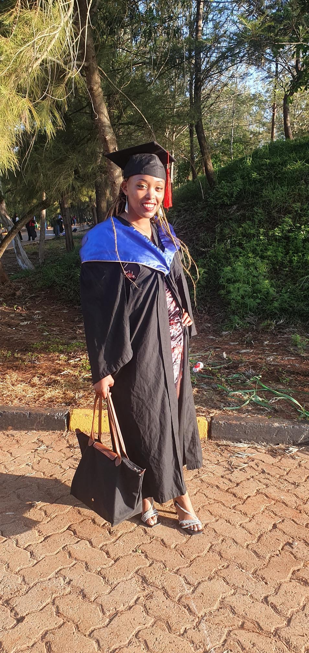

Looking for a Data Analyst? Let’s Connect.
+254 725 135 530
maureenndungu51@gmail.com
in
Maureen Ndungu

